Slide 1
NETWORK TOPOLOGY

Slide 2
NETWORK TOPOLOGY
The layout of a network
Two major classes
Physical Network Topology
    The physical layout of the network i.e. the arrangement and order of the network devices
Logical Network Topology ( Signal Topology)
    How data is actually transferred between the source and receiver in a network

Slide 3
PHYSICAL TOPOLOGY
ONTOLOGY
PEER TO PEER
BUS TOPOLOGY
RING TOPOLOGY
STAR TOPOLOGY
TREE TOPOLOGY
MESH TOPOLOGY
HYBRID TOPOLOGY

Slide 4
POINT TO POINT
TOPOLOGY
Provides a permanent link between two interconnected end points
Dedicated type of design
Examples
    Tin-Can telephones
    Public Address Speaker
    Walky-Talky
Physically dedicated channel

Slide 5
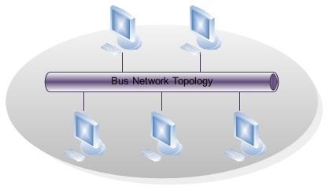
BUS TOPOLOGY

Slide 6
BUS TOPOLOGY
(Cont….)
Elements of Bus Topology
Nodes
Trunk (Bus)
Terminators
Basic Operation

Slide 7
BUS TOPOLOGY
(Cont….)
Collisions
    When two or more devices transmit their messages simultaneously, the signals overlap or cancel each other
    This process may effect the medium also
Carrier Sense Multiple Access/ Collision Detection (CSMA/CD)
Carrier Sense Multiple Access/ Collision Avoidance (CSMA/CA)

Slide 8
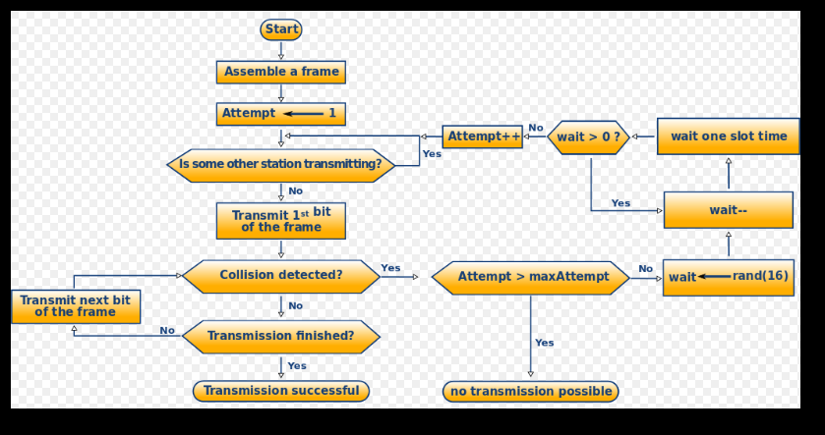
CSMA/CD

Slide 9
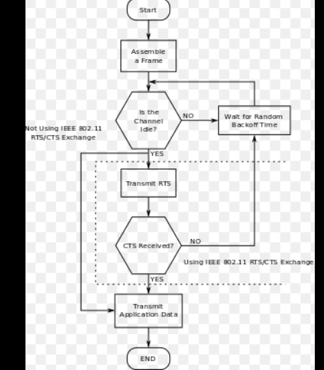
CSMA/CA

Slide 10
BUS TOPOLOGY
(Cont….)
Advantages
    Relatively cheaper to establish
    Failure of one of the station does not affect others.
    Good compromise over the other two topologies as it allows relatively high rate of data transmission.
    Well suited for temporary networks that must be set up in a hurry.
    Easy to implement and extend.

Slide 11
BUS TOPOLOGY
(Cont….)
Disadvantages
    Collisions
    Require a network to detect when two nodes are transmitting at the same time.
    Does not cope well with heavy traffic rates
    Difficult to administer/troubleshoot.
    Limited cable length and number of stations.
    A cable break can disable the entire network; no redundancy.
    Maintenance cost may be higher in the long run.
    Performance degrade as additional computers are added.

Slide 12
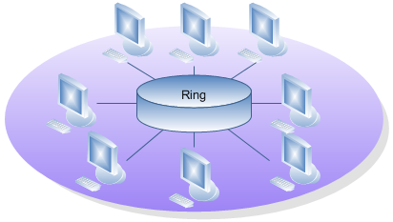
RING TOPOLOGY

Slide 13
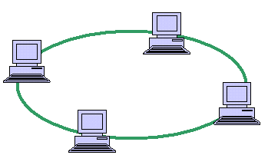
RING TOPOLOGY

Slide 14
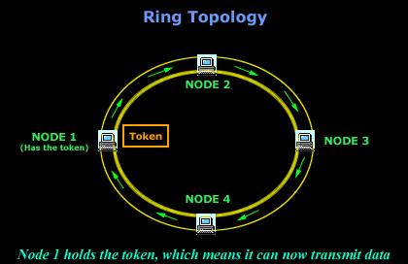
RING TOPOLOGY

Slide 15
RING TOPOLOGY (Cont…)
Nodes
Ring
Token (Parser)
    Operational Working

Slide 16
RING TOPOLOGY (Cont…)
ADVANTAGES
    An orderly network where every device has access to the token and the opportunity to transmit
    Under heavy network load performs better than a star topology.
    To manage the connectivity between the computers it doesn't need network server.
DISADVANTAGES
    One malfunctioning workstation can throw away the entire network.
    Moves, adds and changes of devices can affect the entire network .
    It is slower than an Ethernet network.

Slide 17
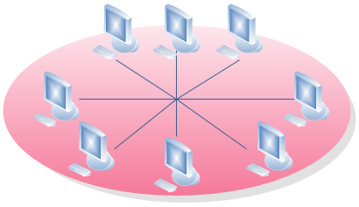
STAR TOPOLOGY

Slide 18
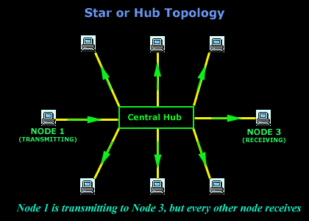
STAR TOPOLOGY

Slide 19
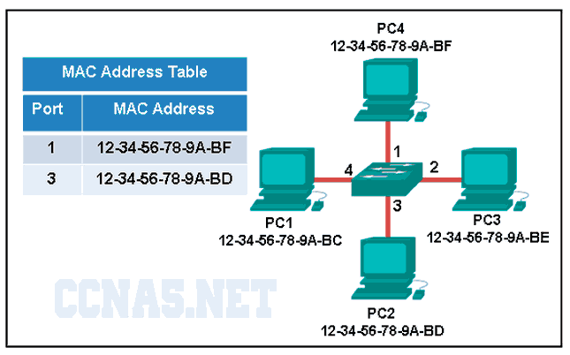
MAC Table: An Example

Slide 20
STAR TOPOLOGY ( Cont … )
Nodes
Hub
Dedicated links
Type of traffic
    Uni Cast
    Multi Cast
    Broad Cast
    Operational Working

Slide 21
STAR TOPOLOGY ( Cont … )
ADVANTAGES:
    The star topology is easy to install and wire.
    The star topology gives a better performance than any other network topology as there is no clogging of nodes. In order to communicate between any two devices only 2 links and 3 devices are involved to prevent confusion. The hub also has adequate capacity to handle high utilization by one device, without disrupting the functioning of the other devices.
    The working of the star topology is simple to establish, understand and navigate. Any fault in the devices connected to the central hub can be detected easily as the malfunctioned device or link is isolated, which allows easy probing into the matter.
    The faulty and defective parts of the network can be easily replaced. Till the links are replaced, the other devices continue their normal functions without any disruptions.
    Expansion of the star topology is easy as the format is very simple thus aiding the growth of networking
DISADVANTAGES:
    Requires more cable length than a linear topology.
    If the hub, switch, or concentrator fails, nodes attached are disabled.
    More expensive than linear bus topologies because of the cost of the hubs, etc

Slide 22
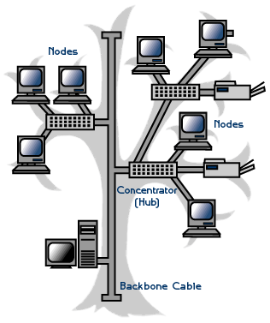
TREE TOPOLOGY

Slide 23
TREE TOPOLOGY
ADVANTAGES:
    It is the best topology for a large computer network for which a star topology or ring topology are unsuitable due to the sheer scale of the entire network. Tree topology divides the whole network into parts that are more easily manageable.
    Tree topology makes it possible to have a point to point network.
    All computers have access to their immediate neighbors in the network and and also the central hub. This kind of network makes it possible for multiple network devices to be connected with the central hub.
    It overcomes the limitation of star network topology, which has a limitation of hub connection points and the broadcast traffic induced limitation of a bus network topology.
    A tree network provides enough room for future expansion of a network.
DISADVANTAGES:
    Dependence of the entire network on one central hub is a point of vulnerability for this topology. A failure of the central hub or failure of the main data trunk cable, can cripple the whole network.
    With increase in size beyond a point, the management becomes difficult

Slide 24
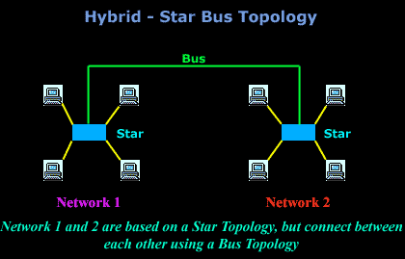
MESH TOPOLOGY

Slide 25
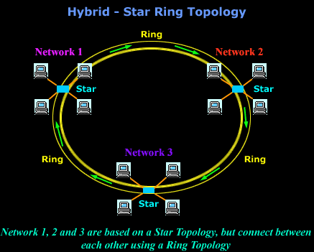
MESH TOPOLOGY

Slide 26
Considerations When Choosing a Topology
Money.
    A linear bus network may be the least expensive way to install a network; you do not have to purchase concentrators.
Length of cable needed.
    The linear bus network uses shorter lengths of cable.
Future growth.
    With a star topology, expanding a network is easily done by adding another concentrator.
Cable type.
    The most common cable in schools is unshielded twisted pair, which is most often used with star topologies.

